Slide 1

DEPARTMENT OF COMPUTER SCIENCE & ENGINEERING
AquaVision-X:A Multimodal CNN-XAI Framework for Marine Plastic Waste Detection Using Drone-Based Aerial Imagery
BATCH ID : 23MPCS-F6
S. No` | Roll. No | Student Name
1 | 23881A05BA | PALEGAR JAGRUTHI
2 | 23881A05Y7 | BUSSI SAI
3 | 23881A05AT | MOHAMMED SOHAIL
Guide Details
Mr.Tummala Vinay Goud
Assistant Professor
Department of CSE

Slide 2
Mini Project Review-2 Outlines
Main idea of the Project
Existing System Vs Proposed
Proposed Project Objectives
Proposed Project Outcomes
Software and Hardware Requirements
Process Model
Design Phase
Architectural Diagram [Modified]
[UML Diagrams or Data Flow Diagrams] and ER-Diagrams ; It should be detailed diagrams
Proposed Methods and Algorithms
Results
Research paper (Acceptance proof)
Conclusion

Slide 3
Main idea of the Project
AquaVision-X is a deep learning framework designed to detect marine plastic waste from aerial drone images.
It uses a Convolutional Neural Network (CNN) to automatically identify plastic debris in ocean and coastal areas. The system combines visual images and environmental metadata to improve detection accuracy under different conditions.
Explainable AI (XAI) techniques such as Grad-CAM are used to show the regions of the image that influence the model’s predictions.
The framework provides a user-friendly interface for image upload, real-time detection, and visualization of results.
The goal is to support marine conservation and environmental monitoring through an accurate and interpretable detection system.

Slide 4
Existing System Vs Proposed
Existing System | Proposed System
Manual monitoring of marine plastic waste | Automated detection using CNN-based deep learning.
Limited analysis using only visual observation. | Uses multimodal data (images + environmental metadata).
No transparency in detection results. | Uses Explainable AI (XAI) to show detection regions.
Difficult to scale for large ocean areas. | Scalable system for large-scale marine monitoring.
DEPARTMENT OF CSE MINI PROJECT REVIEW-4

Slide 5
Existing System Vs Proposed
Existing System | Proposed System
Less accuracy | High accuracy using deep learning
Time-consuming process | Fast and real-time detection
Requires high human effort | Minimal human intervention.
No user-friendly interface | Provides easy-to-use interface
DEPARTMENT OF CSE MINI PROJECT REVIEW-4

Slide 6
Proposed Project Objectives
Develop a CNN-based deep learning model to detect marine plastic waste from aerial drone images.
Build a multimodal framework that combines visual image data and environmental/contextual metadata.
Improve detection accuracy and reliability under different ocean and lighting conditions.
Integrate Explainable AI (XAI) techniques such as Grad-CAM to make the model’s predictions transparent and interpretable.
Create a user-friendly interface for image upload, automatic detection, and visualization of results.

Slide 7
Proposed Project Objectives
Optimize the model for low power devices (edge deployment on drones)
Reduce false positives and false negatives in detection
Implement data preprocessing and augmentation to improve model performance
Enable automatic classification of plastic types (bottles, bags, etc.)
Develop a system for continuous learning with new data (model updates)
Ensure fast processing time for near real-time predictions
Provide visual analytics/dashboard for monitoring results
Improve generalization of model across different ocean regions

Slide 8
Proposed Project Outcomes
Successfully developed a CNN-based model to detect marine plastic waste from aerial drone images.
Achieved accurate identification of plastic debris in different marine environments.
Explainable AI (XAI) techniques such as Grad-CAM generate heatmaps showing the regions influencing the model’s prediction.
Implemented a user-friendly interface for uploading images and performing real-time detection.
The system displays bounding boxes and visual explanations, making the detection process clear and interpretable.

Slide 9
Software and Hardware Requirements
Deep Learning Framework
TensorFlowKerasPyTorch (optional)
Libraries and Packages
NumPy – Numerical computationsPandas – Data processingOpenCV – Image processingMatplotlib / Seaborn – Data visualizationScikit-learn – Machine learning utilities
Explainable AI (XAI) Tools
Grad-CAMLIME (Local Interpretable Model-agnostic Explanations)
Dataset Management
Kaggle / Custom Marine Debris Dataset

Slide 10
Process Model
Collect aerial drone images of marine environments containing plastic waste.
Data PreprocessingResize images, remove noise, and normalize data for better model performance.
Feature Extraction using CNN The Convolutional Neural Network (CNN) extracts important features from the images.
Multimodal Data Integration Combine image data with environmental metadata such as water conditions, lighting, and location.
Plastic Waste DetectionThe trained model detects marine plastic debris and identifies their locations.
Explainable AI (XAI) Analysis Use Grad-CAM to generate heatmaps showing which regions influenced the prediction.
Result Visualization bounding boxes and heatmaps through a user-friendly .

Slide 11
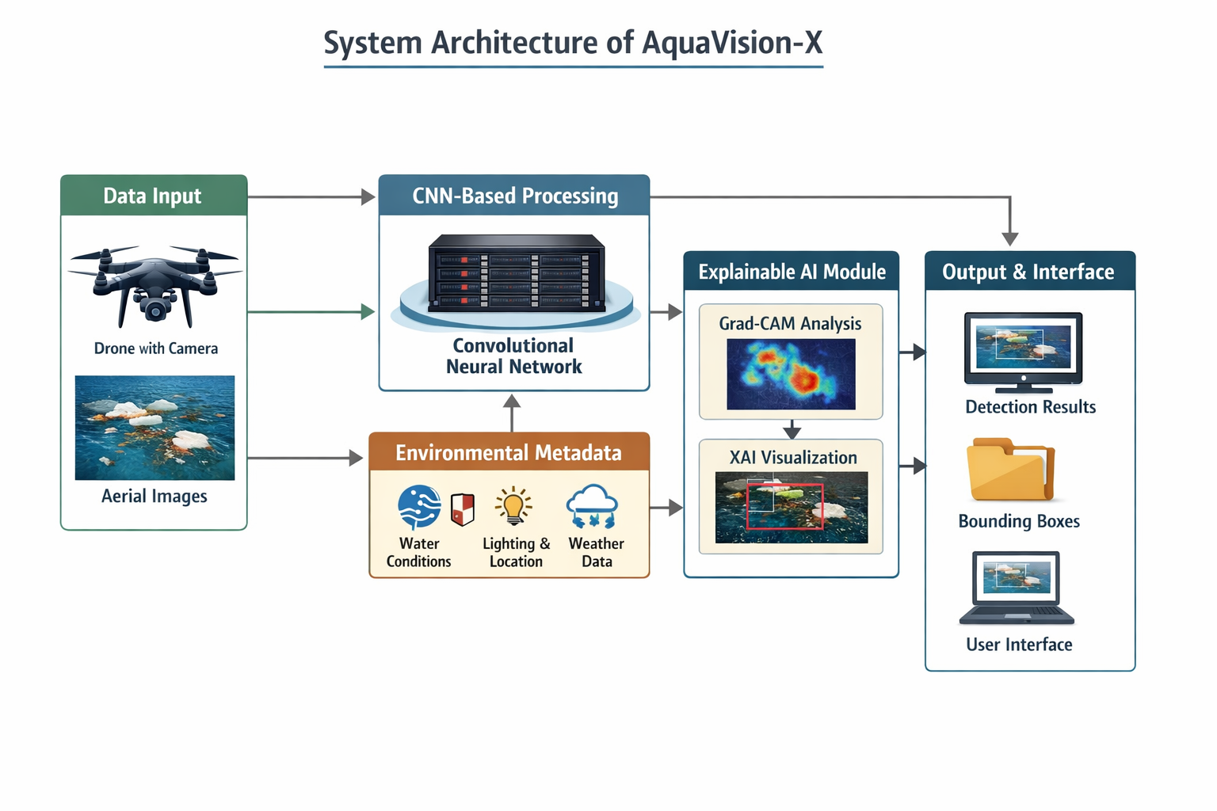
Architectural Diagram

Slide 12
PROPOSED METHOD AND ALGORITHMS
Proposed Method
Collect aerial drone images containing marine environments.
Perform image preprocessing such as resizing, normalization, and noise removal.
Use a Convolutional Neural Network (CNN) to detect marine plastic waste from the images.
Combine visual data with environmental metadata (water condition, lighting, location) to improve accuracy.
Apply Explainable AI (XAI) techniques to interpret the model’s predictions.
Display the detected plastic regions using bounding boxes and heatmaps through the user interface.
Algorithms Used
Convolutional Neural Network (CNN) – for image classification and detection.
Grad-CAM (Gradient-weighted Class Activation Mapping) – for Explainable AI visualization.
Image Preprocessing Algorithms – resizing, normalization, and feature extraction.
Multimodal Data Integration – combining image data with environmental metadata.

Slide 13
Results
The AquaVision-X model successfully detects marine plastic waste from aerial drone images.
The CNN model achieved high detection accuracy in identifying plastic debris in different marine environments.
Explainable AI (XAI) techniques such as Grad-CAM generated heatmaps highlighting important regions influencing the model’s prediction.
The system displayed bounding boxes around detected plastic waste in the images.
The user interface allowed easy image upload and real-time visualization of detection results.

Slide 14
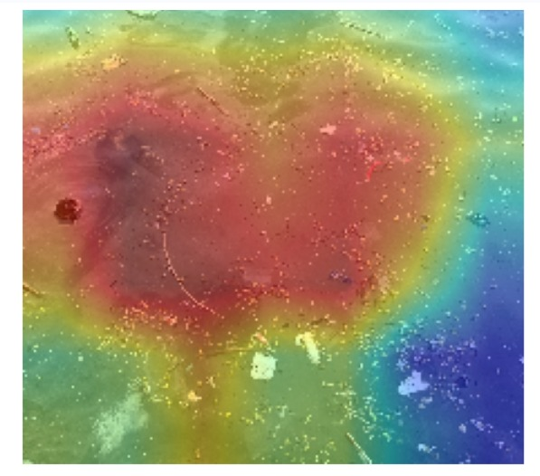
Results
Grad-CAM heatmap representation indicating features importance
Region in the input image.

Slide 15
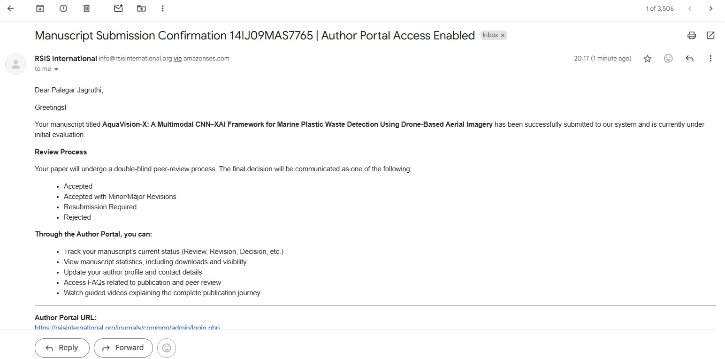
Research paper (Acceptance proof
Paper Status Applied.

Slide 16
Advantages
High accuracy in detecting marine plastic waste
Reduces manual effort and human error
Provides explainable results using Grad-CAM
Works under different environmental conditions
Scalable for large-scale ocean monitoring
Supports real time or near real-time detection
User-friendly interface for easy operation

Slide 17
Future Scope
Real Time detection using drones and underwater robots
Integration with IoT sensors for continuous monitoring
Development of mobile/web application for easy access
Use of advanced models like YOLO for better accuracy
Expansion to detect other marine pollutants (oil spills, chemicals)
Deployment in large-scale ocean monitoring systems
Integration with satellite imagery for large-scale monitoring
Use of real time alert systems to notify authorities about pollution

Slide 18
Conclusion
The AquaVision-X framework successfully detects marine plastic waste using a CNN-based deep learning model.
The system improves detection reliability by combining visual drone imagery with contextual environmental data.
Integration of Explainable AI (XAI) techniques provides transparent and interpretable results through visual heatmaps.
The developed interface enables easy image upload, automated detection, and visualization of results.
Overall, the system offers a scalable and effective solution for marine pollution monitoring and conservation efforts.

Slide 19
Thank You

